Slide 1
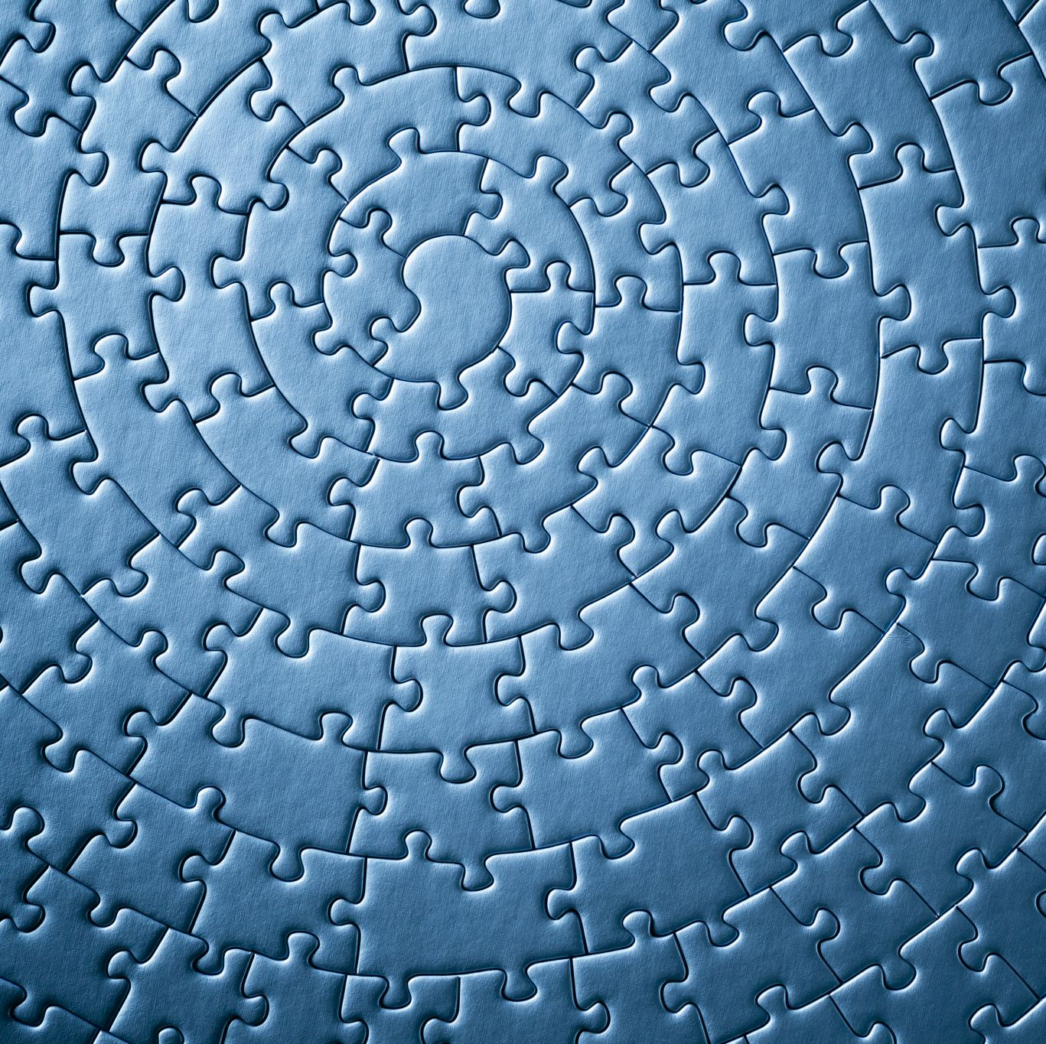
Welcome to Sonya Kovalevsky Day!
@ Washington University in St. Louis
Speaker: Lara Pudwell, Valparaiso University

Slide 2
Today’s plan
About me
A puzzling card trick
The math of sequences

Slide 3
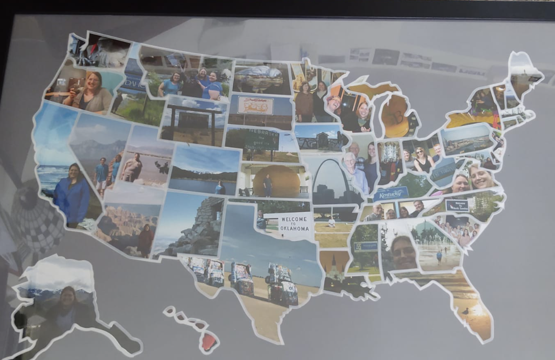
My hometowns (past & present)

Slide 4
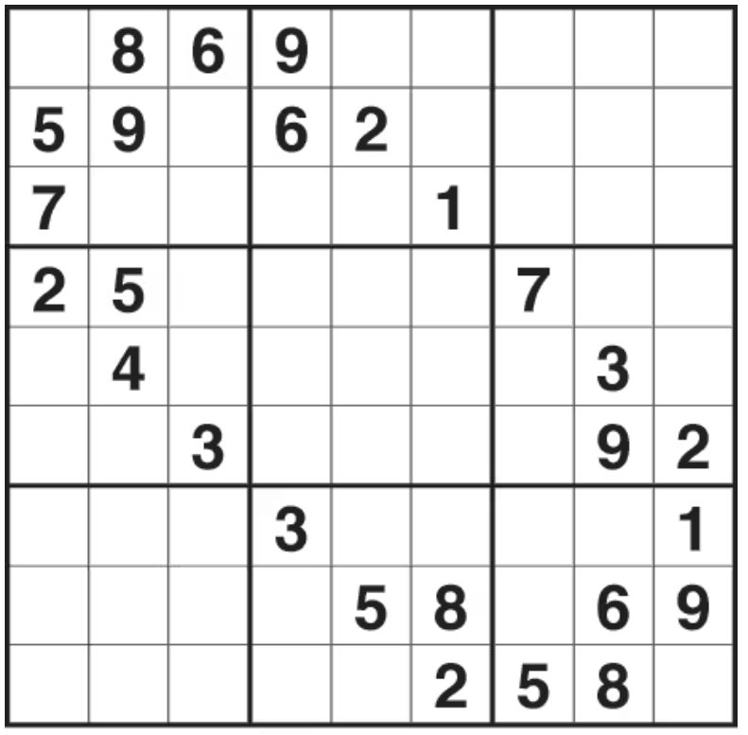
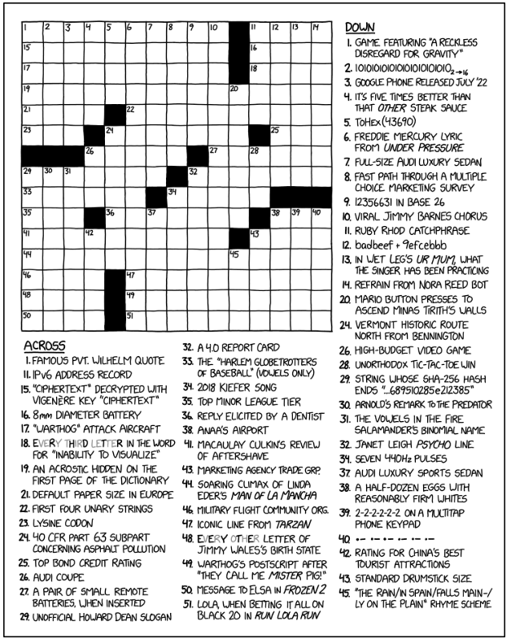
Things I enjoy…

Slide 5
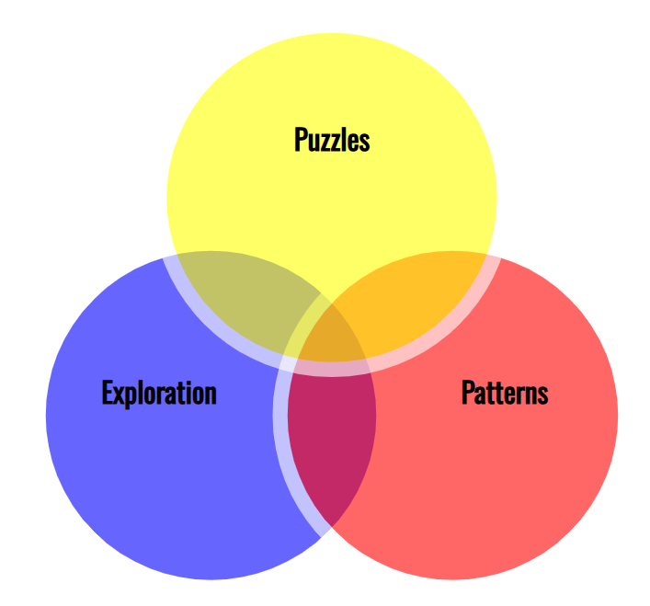

Slide 6
9 dots
Connect the dots using 4 lines… without picking up your pencil.
Connect the dots using 4 lines

Slide 7
9 dots
Connect the dots using 4 lines… without picking up your pencil.

Slide 8
9 dots
Connect the dots using 4 lines… without picking up your pencil.

Slide 9
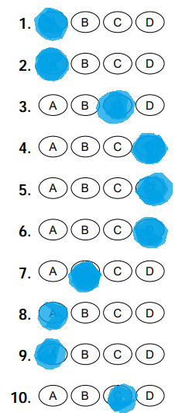
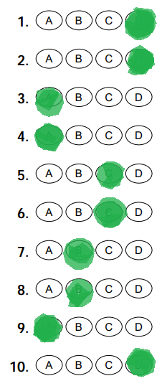
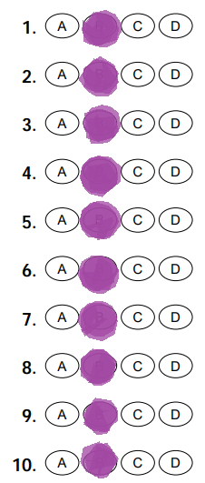
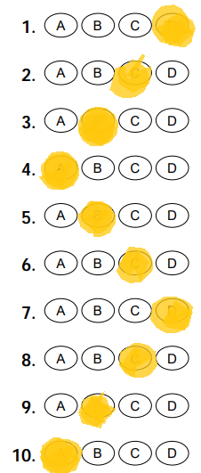
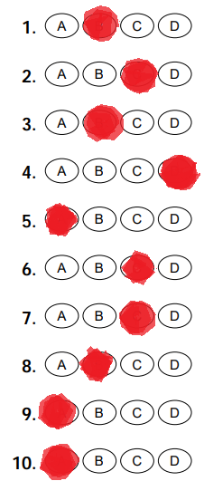
Pop quiz!
Score (out of 10) | Expected number of students
6+ | 0
5
4
3
2
1
0
Score (out of 10) | Expected number of students
6+ | 0
5 | 1
4 | 4
3 | 6
2 | 7
1 | 5
0 | 1

Slide 10
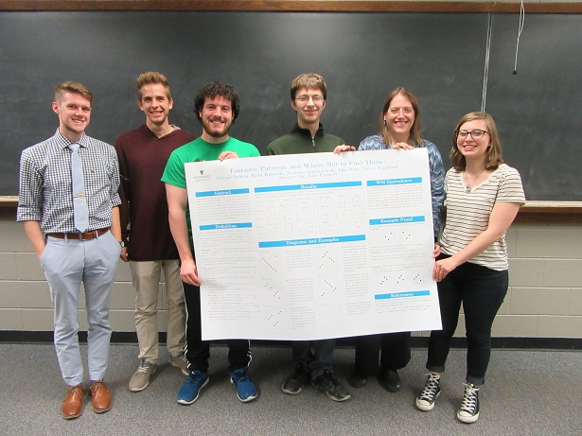
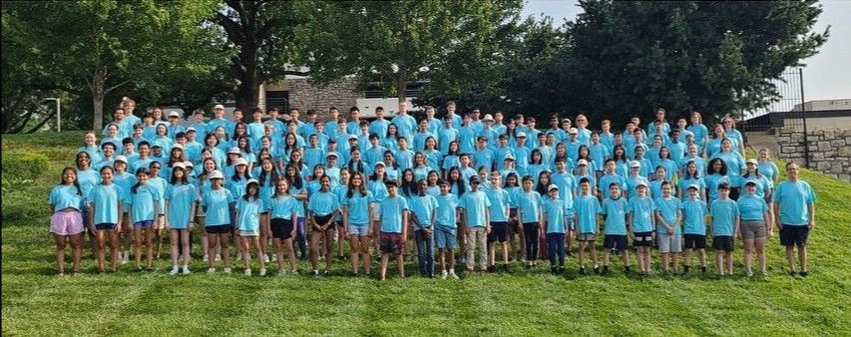
My path since high school
(college)
(graduate school)

Slide 11
A puzzling card trick
5 volunteers?
Given information: a pattern of 5 card colors Figure out: all 5 cards!

Slide 12
Binary strings
Binary = uses 0s and 1s
Binary strings of length 2?
00 01 10 11
DeBruijn Sequence: 0011 (contains every string once)
DeBruijn Sequence: (contains every string once)

Slide 13
Binary strings
Binary = uses 0s and 1s
Binary strings of length 3? (and a DeBruijn sequence?)
000 010 100 110 001 011 101 111
DeBruijn Sequence: 00010111 (contains every string once)
DeBruijn Sequence: (contains every string once)

Slide 14
DeBruijn… graph?
0011

Slide 15
DeBruijn… graph?
00010111
00011101

Slide 16
DeBruijn… graph?

Slide 17
DeBruijn… graph?
0000111101001011

Slide 18
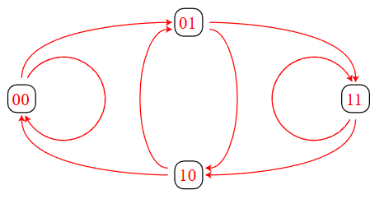
DeBruijn graphs
Notice: Two in-arrows per node, and two out-arrows per node

Slide 19
Length 5:
00000111110101001101100101110001
With cards?
BBBBBRRRRRBRBRBBRRBRRBBRBRRRBBBR

Slide 20
Actual cards:
C
H
S
D
8C AC 2C 4C AS 2D 5C 3S 6D 4S AH 3D 7C 7S 7H 6H 4H 8H AD 3C 6C 5S 3H 7D 6S 5H 2H 5D 2S 4D 8S 8D
How do you memorize a list of 32?
(You don’t; it’s more binary math!)

Slide 21
Actual cards:
C
H
S
D
8C AC 2C 4C AS 2D 5C 3S 6D 4S AH 3D 7C 7S 7H 6H 4H 8H AD 3C 6C 5S 3H 7D 6S 5H 2H 5D 2S 4D 8S 8D
4 suits: C, H, S, D 8 values: A, 2, 3, 4, 5, 6, 7, 8
4 binary strings of length 2: 00, 01, 10, 11 8 binary strings of length 3: 000, 001, 010, 011, 100, 101, 110, 111

Slide 22
Actual cards:
C
H
S
D
8C AC 2C 4C AS 2D 5C 3S 6D 4S AH 3D 7C 7S 7H 6H 4H 8H AD 3C 6C 5S 3H 7D 6S 5H 2H 5D 2S 4D 8S 8D
00 | Club
01 | Spade
10 | Diamond
11 | Heart
001 | A
010 | 2
011 | 3
100 | 4
101 | 5
110 | 6
111 | 7
000 | 8

Slide 23
Actual cards:
C
H
S
D
8C AC 2C 4C AS 2D 5C 3S 6D 4S AH 3D 7C 7S 7H 6H 4H 8H AD 3C 6C 5S 3H 7D 6S 5H 2H 5D 2S 4D 8S 8D
00 | Club
01 | Spade
10 | Diamond
11 | Heart
001 | A
010 | 2
011 | 3
100 | 4
101 | 5
110 | 6
111 | 7
000 | 8

Slide 24
Actual cards:
C
H
S
D
8C AC 2C 4C AS 2D 5C 3S 6D 4S AH 3D 7C 7S 7H 6H 4H 8H AD 3C 6C 5S 3H 7D 6S 5H 2H 5D 2S 4D 8S 8D
00 | Club
01 | Spade
10 | Diamond
11 | Heart
001 | A
010 | 2
011 | 3
100 | 4
101 | 5
110 | 6
111 | 7
000 | 8

Slide 25
Actual cards:
C
H
S
D
8C AC 2C 4C AS 2D 5C 3S 6D 4S AH 3D 7C 7S 7H 6H 4H 8H AD 3C 6C 5S 3H 7D 6S 5H 2H 5D 2S 4D 8S 8D
00 | Club
01 | Spade
10 | Diamond
11 | Heart
001 | A
010 | 2
011 | 3
100 | 4
101 | 5
110 | 6
111 | 7
000 | 8
Important:
Every 5-card Black/Red pattern appears once.
Every 5-card Black/Red pattern describes the suit and number of the first card in that 5-card list.

Slide 26
Actual cards:
C
H
S
D
8C AC 2C 4C AS 2D 5C 3S 6D 4S AH 3D 7C 7S 7H 6H 4H 8H AD 3C 6C 5S 3H 7D 6S 5H 2H 5D 2S 4D 8S 8D
00 | Club
01 | Spade
10 | Diamond
11 | Heart
Questions?
How much information do we have from the 5 volunteers?
How much information do we need to get all 5 cards?
001 | A
010 | 2
011 | 3
100 | 4
101 | 5
110 | 6
111 | 7
000 | 8

Slide 27
Actual cards:
C
H
S
D
8C AC 2C 4C AS 2D 5C 3S 6D 4S AH 3D 7C 7S 7H 6H 4H 8H AD 3C 6C 5S 3H 7D 6S 5H 2H 5D 2S 4D 8S 8D
00 | Club
01 | Spade
10 | Diamond
11 | Heart
If we know 5 cards, we need the next 4 colors.
Binary arithmetic:
001 | A
010 | 2
011 | 3
100 | 4
101 | 5
110 | 6
111 | 7
000 | 8

Slide 28
DeBruijn Torus

Slide 29
DeBruijn Torus

Slide 30
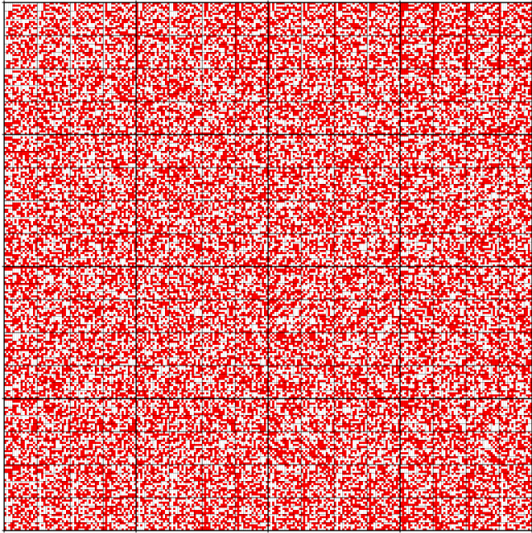
DeBruijn Torus

Slide 31
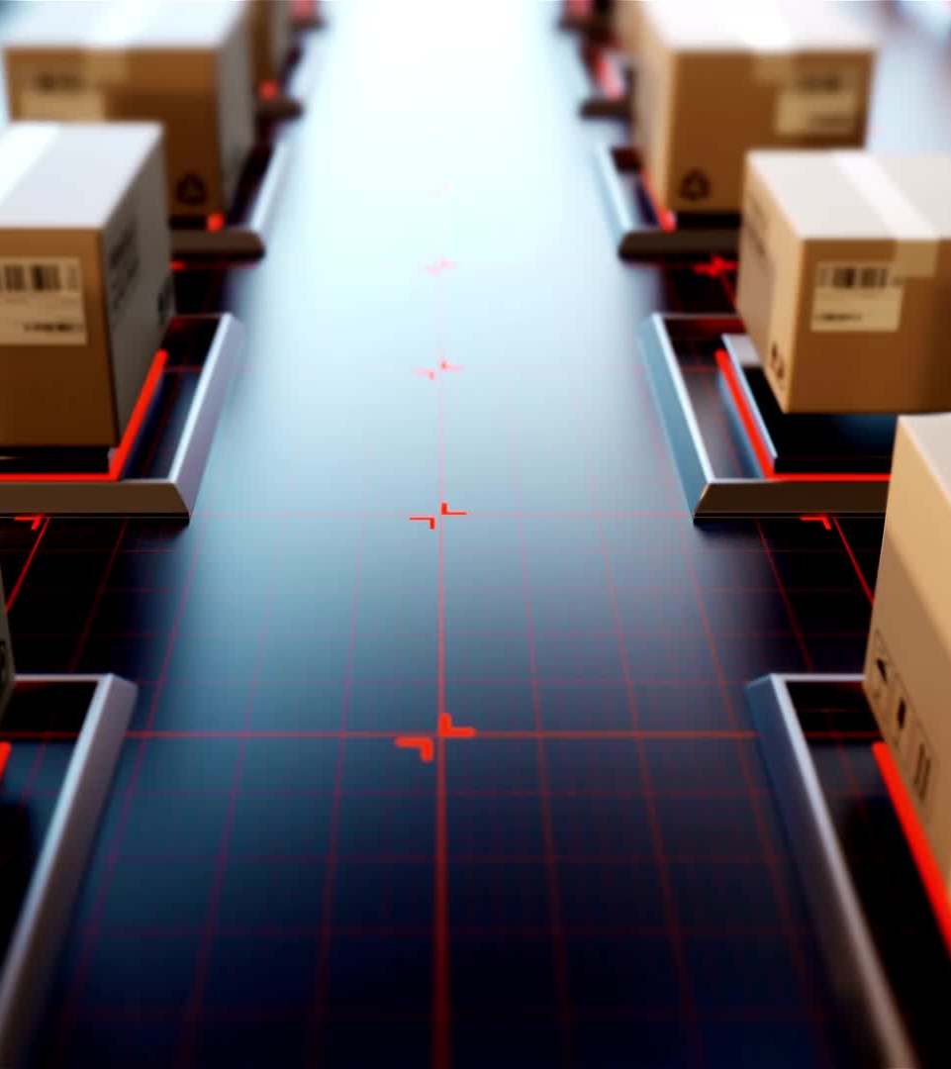
Why care?

Slide 32
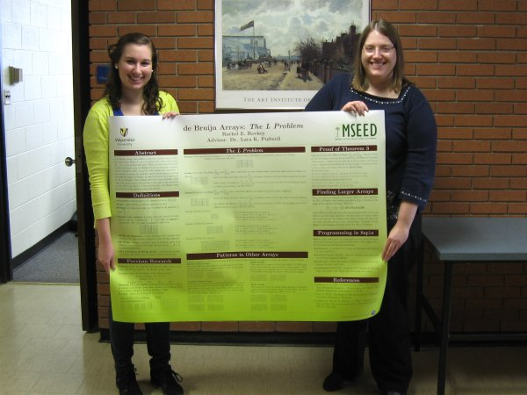
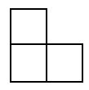
DeBruijn L arrays

Slide 33
0 | 0 | 1 | 1
0 | 1 | 1 | 0
DeBruijn L arrays

Slide 34
0 | 0 | 1 | 1
0 | 1 | 1 | 0
DeBruijn L arrays

Slide 35
0 | 0 | 1 | 1
0 | 1 | 1 | 0
DeBruijn L arrays

Slide 36
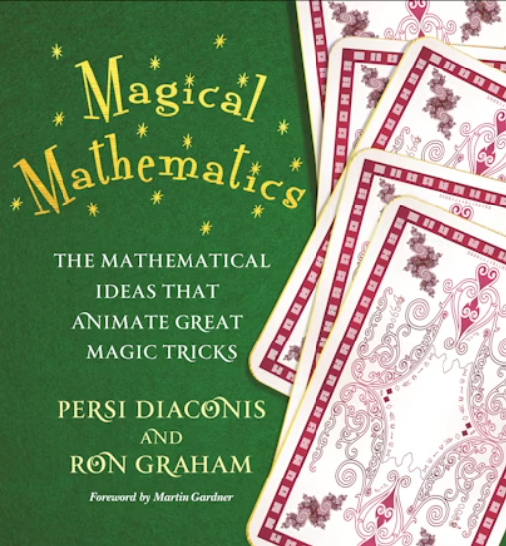
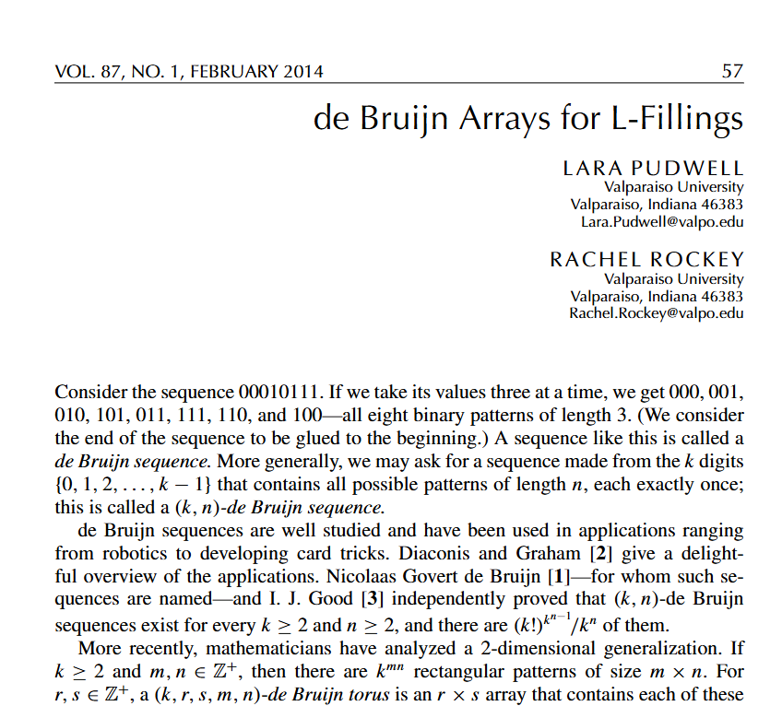
Mathematics Magazine
Thanks for coming!

